Slide 1
Mulesoft Usage based model

Slide 2

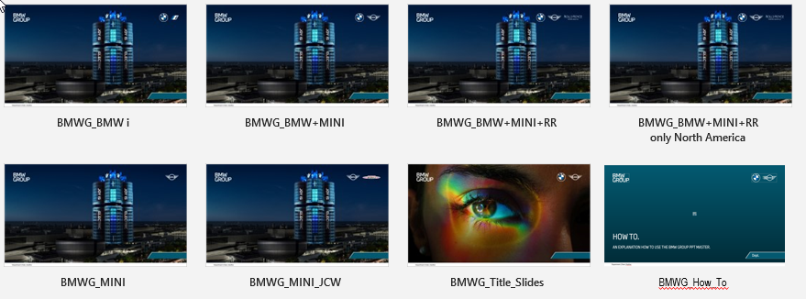
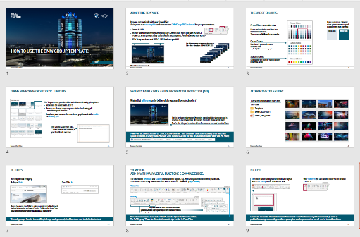
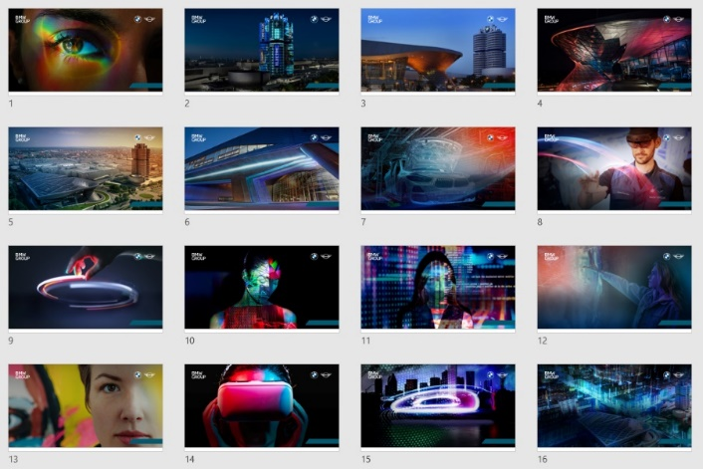

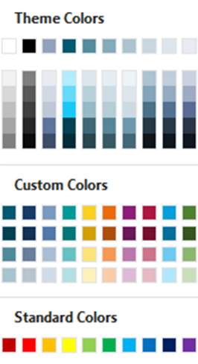


Relevant user information.
Please find additional Masters (for different sender designations), a “How To” document and Title Slides in PowerPoint – file – new…
(Templates)
BMW GROUP 2021:
Use only official imagery.
DAM
Pressclub
BMWG_How_To
BMWG_Title_Slides
With °PowerOn you can easily edit the footer via the function “FOOTER”.
The ribbons °PowerOn, °Gallery and °Chronos offer additional support, e.g. by inserting example slides with just on click. → Get it @ WUSS*
Ocean Blue is our main colour.
If you use text on coloured areas please ensure a good legibility with high contrast.
The blank space is reserved for the Azure Information Protection confidentiality signature which has to be visible on all slides.
White text
Black text
*Search for „PowerOn“

